Slide 1
Comparative evaluation of Differential Gene Expression Analyses Tools
MBIO7160
Abdul-Rahman Adamu Bukari
19/11/29

Slide 2
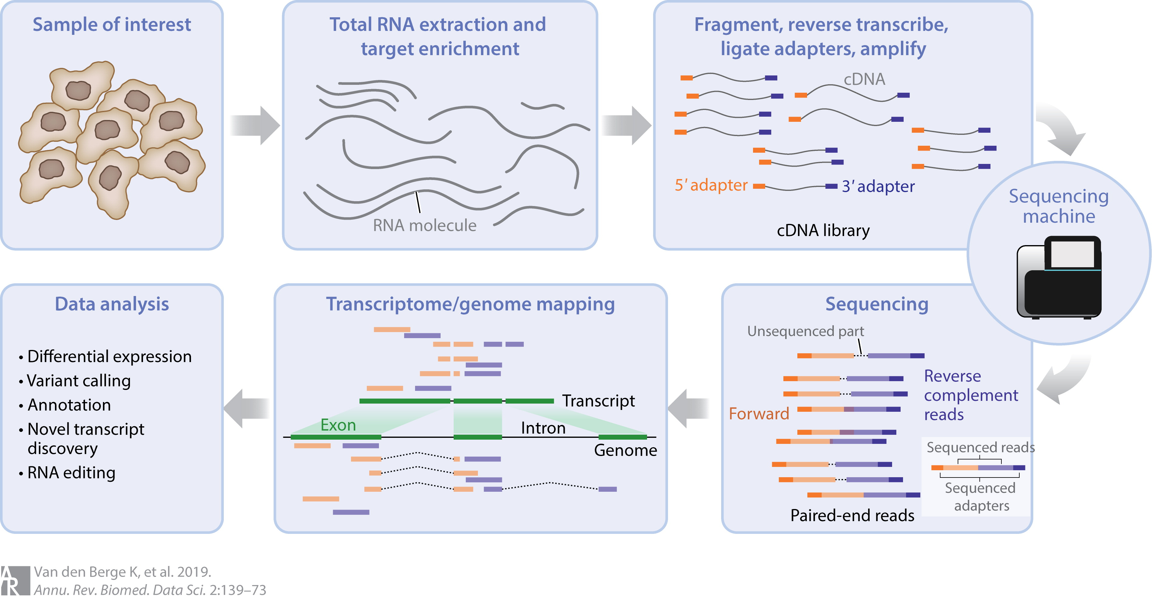
Differential Gene Expression Analyses is a component of RNA-seq
RNA-seq is a method of obtaining a snapshot of genes being expressed by a biological system.
Applications
Developmental biology
Transcriptome discovery
Understanding disease pathologies
Differential expression analysis (DEA): performing statistical analysis of read counts to discover genes with significant quantitative changes in expression levels between experimental groups.

Slide 3
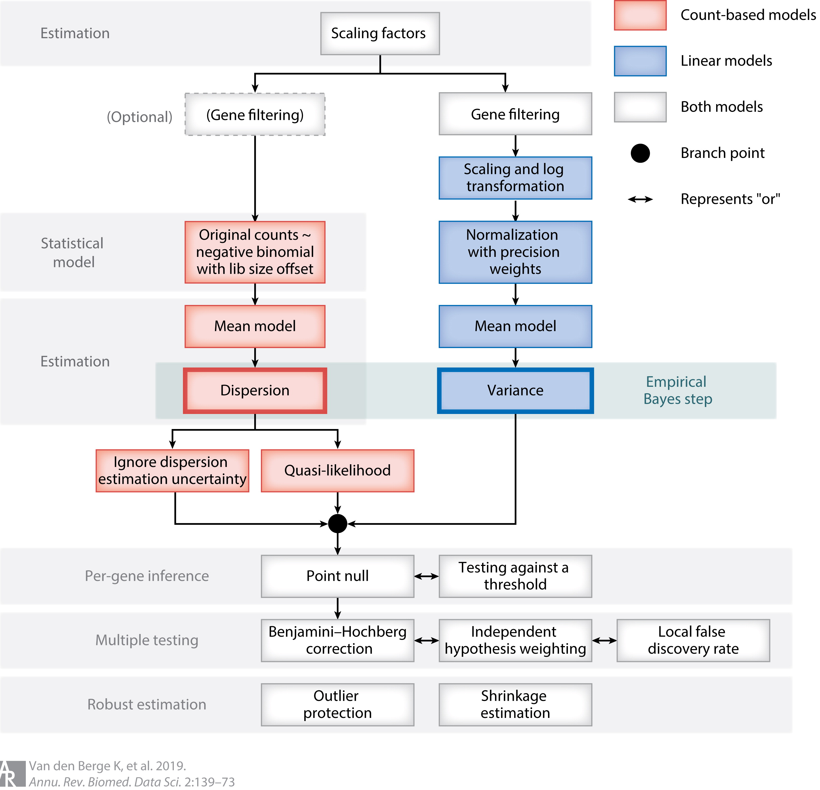
DEA
- Starts with a count table with rows representing genes/transcripts and columns representing samples
- The goal of DE is to formulate and test a statistical hypothesis for each gene/transcript.
Challenges:
Limited number of replicates
Variations introduced by biological replicates
Low count genes
Modelling Parameters to adopt

Slide 4
Real Challenge: Distribution Models
Various distribution models proposed by
various tools:
Poisson
Negative bionomal
Binomial
Non-parametric
Bayesian
Do these distributions model the data correctly?
Are the results from from these tools accurate and comparable?
Aim
Evaluate the performance of three differential expression analysis tools (Deseq2, DEGseq, NOISeq) working with different distribution models.

Slide 5
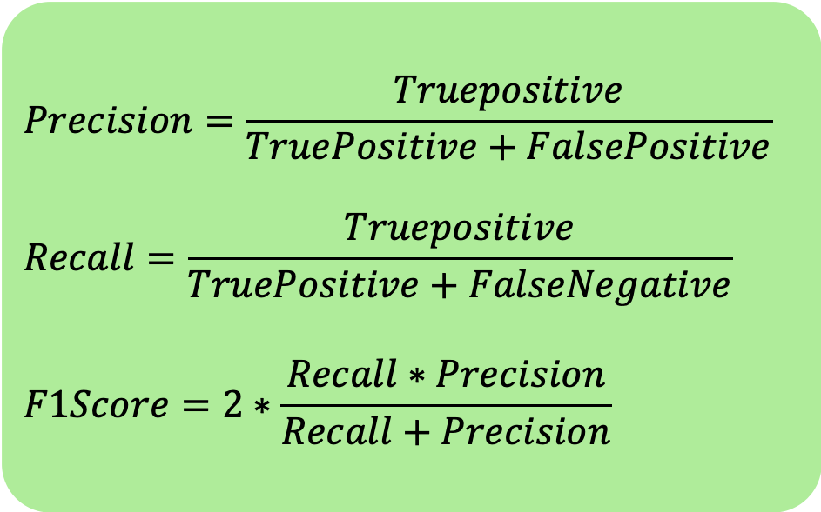
Methods
Count data simulation
generateSyntheticData
- NB distribution
- 13000 genes with 10% DE
- Two groups: 5 replicates each
- Zero count genes filtered
- 4 replicates of datasets
- DESeq2
- DEGseq
- NOISeq
adjP-value threshold=0.05
Q value for NOISeq=0.8
Default parameters unless necessary to avoid bias
Differential Gene expression analysis
$$Precision=\frac{Truepositive}{TruePositive+FalsePositive}$$
$$Recall=\frac{Truepositive}{TruePositive+FalseNegative}$$
$$F1Score=2∗\frac{Recall∗Precision}{Recall+Precision}$$
Evaluation of performance

Slide 6
Data Quality
Count distribution
Heat map after vst transformation

Slide 7
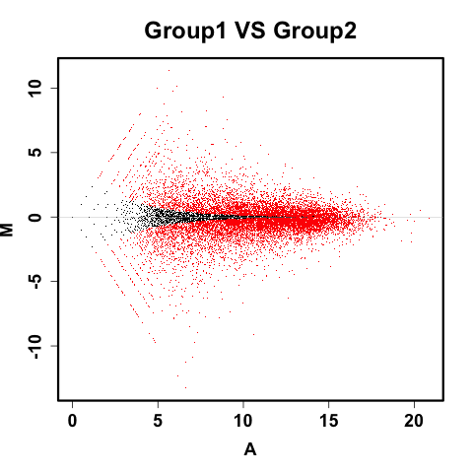
DEG Identified

Slide 8
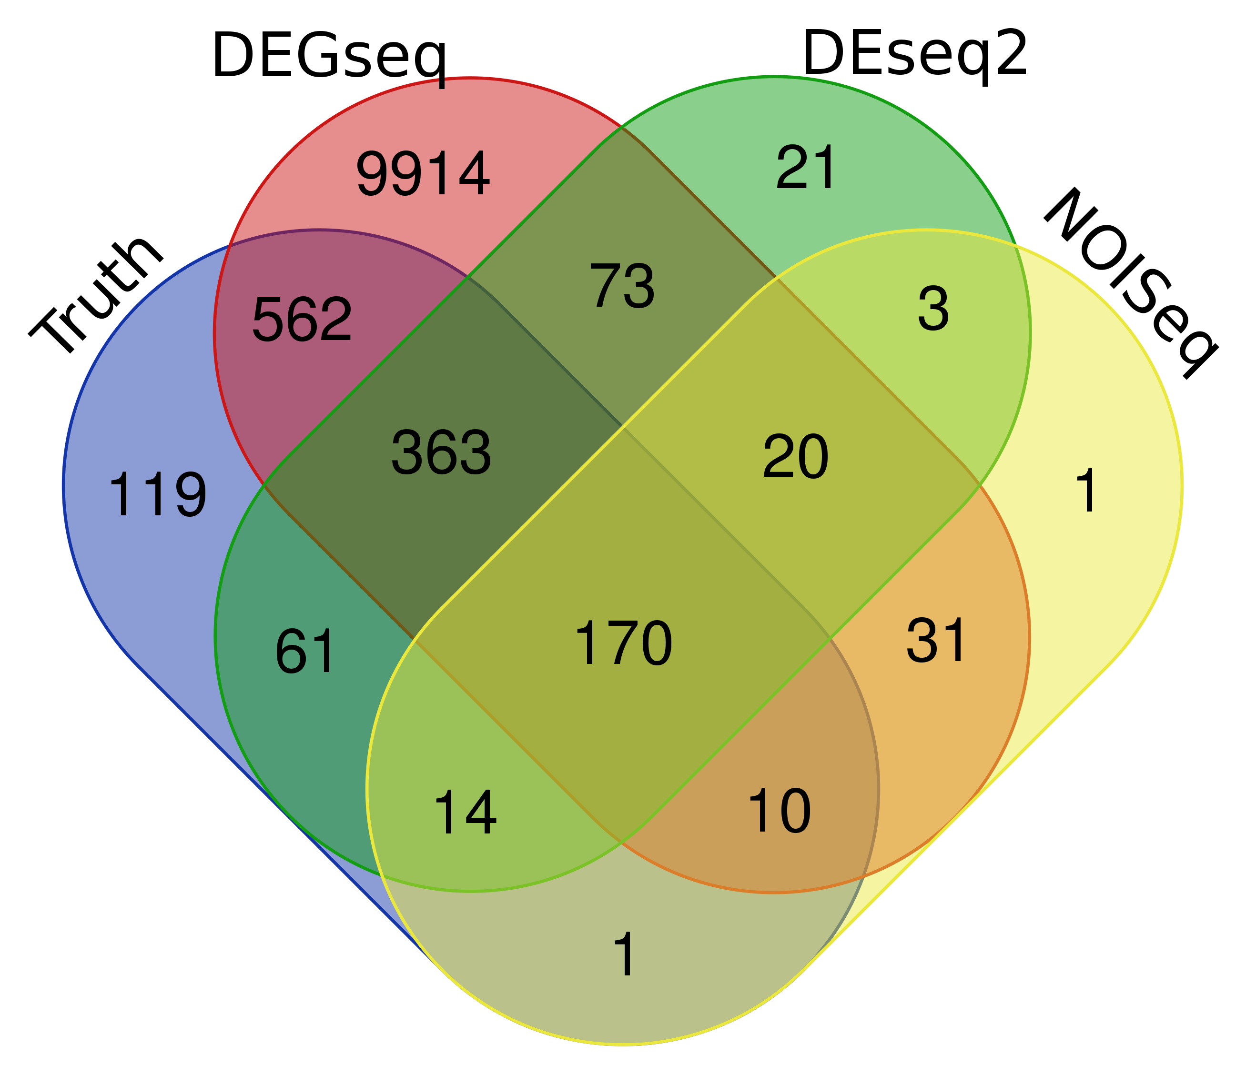
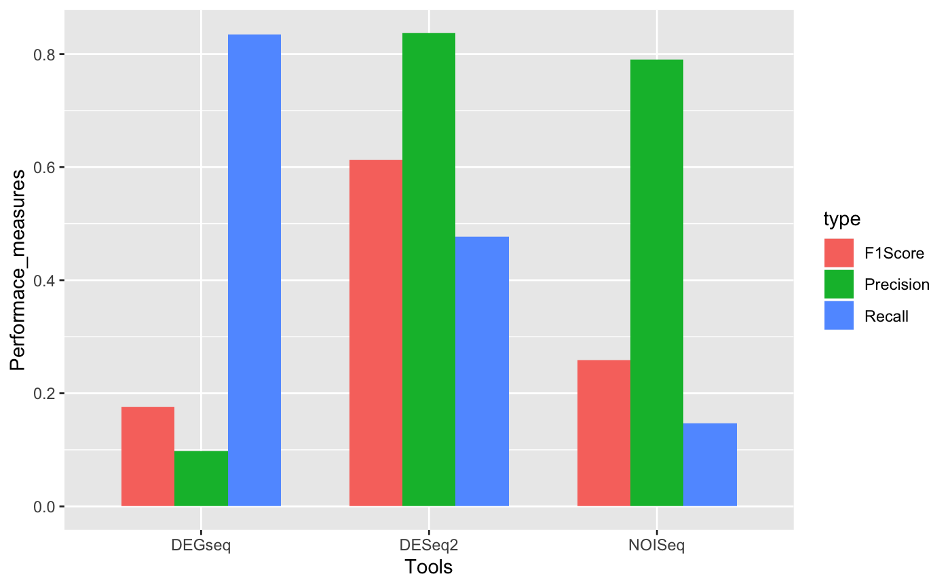
Performance of tools

Slide 9
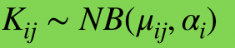
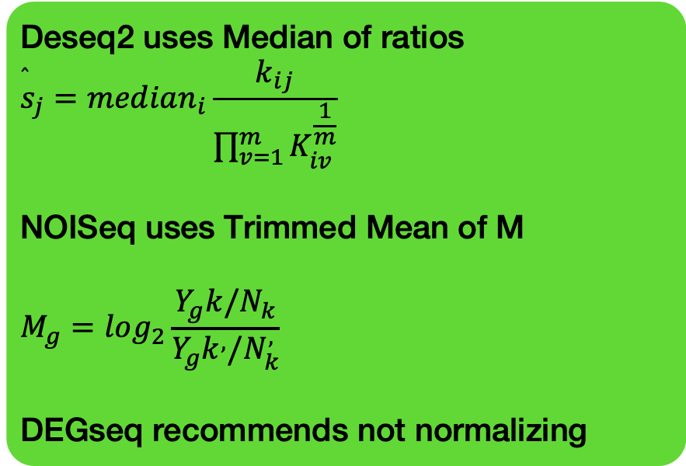
DGEA WORKFLOW
Normalization
Deseq2 uses Median of ratios
$${\overset{̂}{s}}_{j}=median_{i}\frac{k_{ij}}{\prod_{v=1}^{m}{K_{iv}^{\frac{1}{m}}}}$$
NOISeq uses Trimmed Mean of M
$$M_{g}=log_{2}\frac{Y_{g}k/N_{k}}{Y_{g}k^{,}/N_{k}^{,}}$$
DEGseq recommends not normalizing
DESeq2 uses the Gamma Poisson distribution
NOISeq is non-parametric
DEGseq bionomial distribution
Ci ∼ binomial (ni, pi)
Parameter estimation of a statistical model
Desq2 uses the Wald test with p -values corrected with Benjamini and Hochberg method
NOISeq uses a predefined odds ratio
DEGSeq uses the likelihood-ratio test with p-values corrected with Benjamini and Hochberg method
Test for diffferential expression

Slide 10
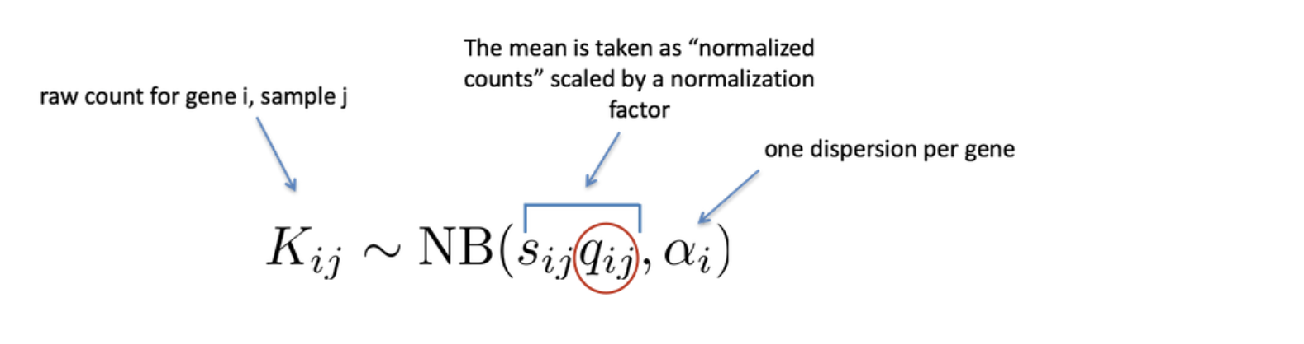
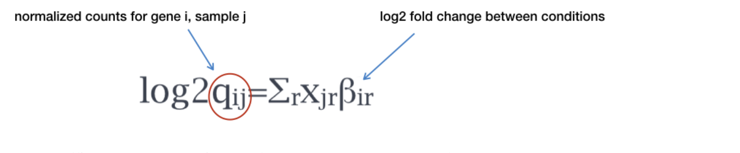
Log fold change shrinkage
Deseq2 Workflow: The NB distribution
Modelling Raw count for each gene

Slide 11
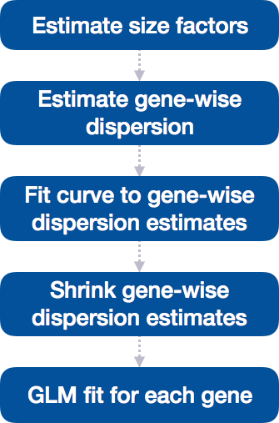
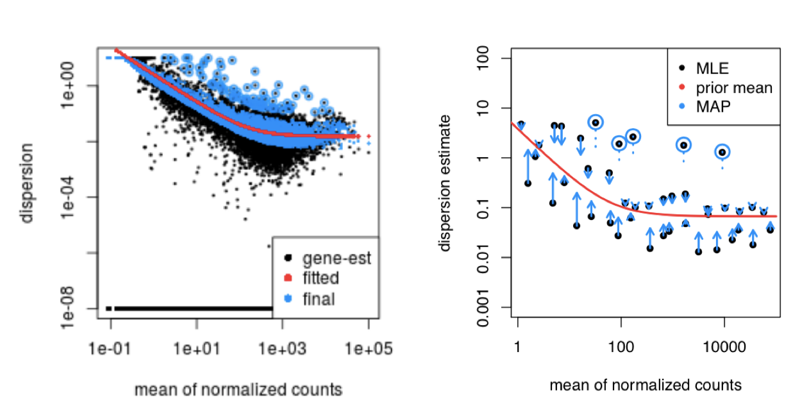
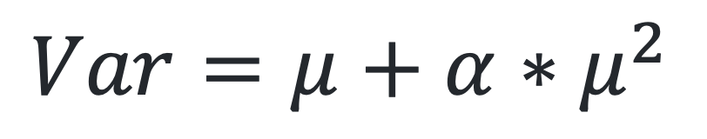
Modelling Raw count for each gene
$$Var=μ+α∗μ^{2}$$
}

Slide 12

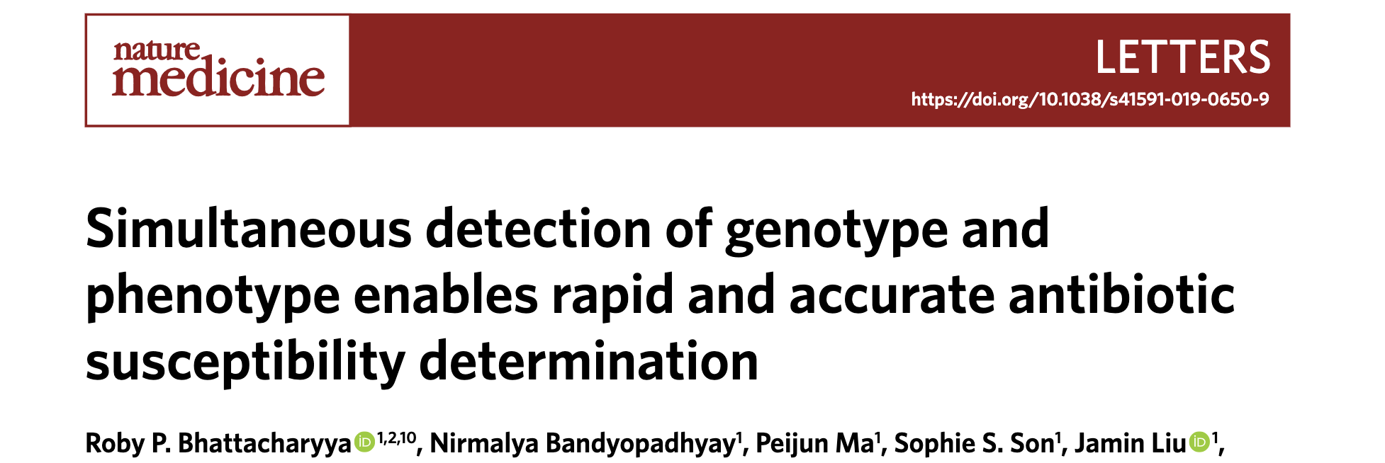

Applications
DEGseq
DEseq2
NOISeq

Slide 13
Future Directions
Optimized normalization strategies
GC content
Transcripts length bias
Hypervariable biological replicates
What if more genes are differentially expressed
Real reliable benchmarking datasets
Future enhancement of these tools will depend on innovations in sequencing technologies

Slide 14
Thank you

